Slide 1
CA M&S in DEVS-Suite Simulator

Slide 2
CA Playback
Add a textbox (positive integer number) for setting the duration of playback (next to the slider)
Number of steps to go back
Pause/resume animation while simulation running
Number of cells that have changed during the designated period

Slide 3
CA Animation Speed
Add a textbox next to the slider (positive integer numbers)
Do the same for the Component model
Do the same for Real-time factor
Do the same for time view update factor
Changing updates at run-time – implications including accurate start and end times (adding start and end time for animation)
Allow user choose what (state variables) to be displayed using tooltip

Slide 4
CA Model Viewer
Timeview for CA (selecting ports given Moore, von Newman, and customized neighborhood couplings)
Field of view (neighborhood coordinates)
initialization
Hexago, etc layout?

Slide 5
Modeling – 1-D and 2-D
Number of cells
Number of state variables
Number of active cells
Number of I/O events
Torus neighborhood ?

Slide 6
Scalability (model, visualization, execution)
Replacing explicit I/O couplings with direct connections (modularity)
Inclusion or exclusion of CM and CA animation (provide a switch to turn on/off)
Exporting data to DB (Gregg)
Coordination of Timeview and CA View (as in Timeview and CM View)
Execution on multi-core (parallelization)?

Slide 7
TimeView, AnimationView, (Comp and CA) UI design
Steps to choose CM and CA models
Things to display and things to hide incrementally during simulation set-up

Slide 8
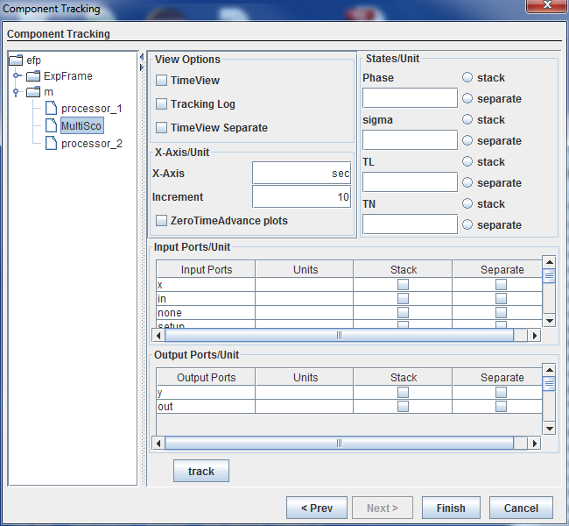
Trajectory Tracking Configuration
Widths for Stack and Separate columns need to be smaller
Primary States
Phase
Sigma
Microsecond
Millisecond
Seconds
Minute
Hour
Days
Months
Years
_____
Replace
1
4
2
3
Dropdown menu / allowing user entry
Simulator Clock
tL
tN

